Slide 1
MEDIA V/S HEALTH
File created on: 8/15/2023 9:50:24 AM

Slide 2
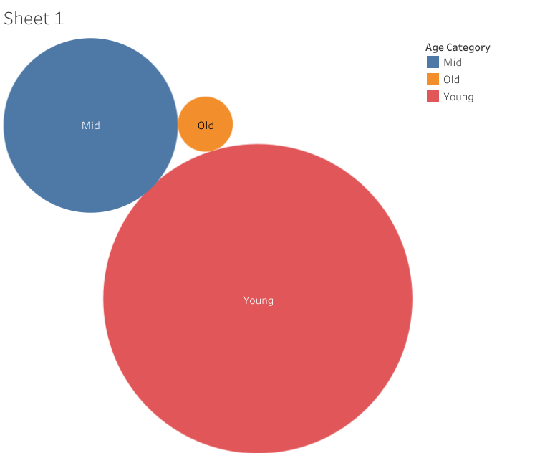

Slide 3
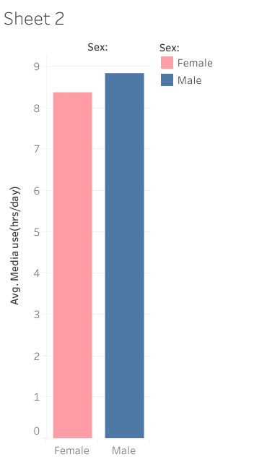

Slide 4
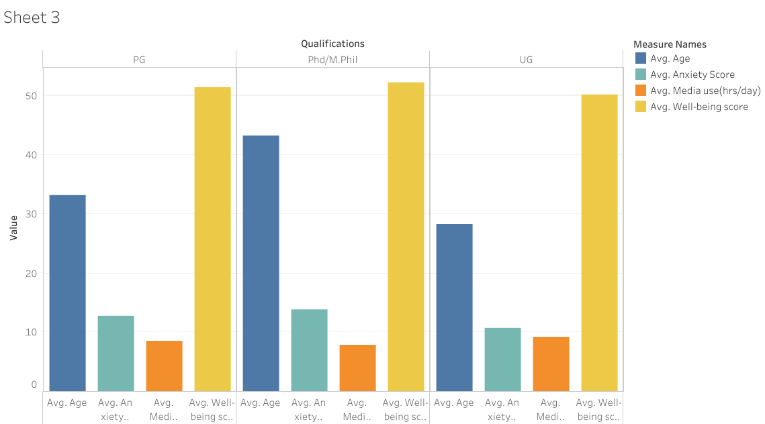

Slide 5
